Slide 1

Welcome & Module Induction
What we learned previously: In Module 11, we learned how to serve our code to the world using FastAPI and Uvicorn.
What we are learning today: We are learning how to do more than one thing at a time. We will explore Multi-threading (for tasks that wait), Multiprocessing (for heavy math), and the infamous GIL (the internal speed limit of Python).
Why this will be helpful: Standard Python code is "Synchronous," meaning it does one task at a time. If you are downloading 100 images for a dataset, your code waits for Image 1 to finish before starting Image 2. Today, you will learn how to make your computer work in parallel, cutting your processing time from minutes to seconds.

Slide 2
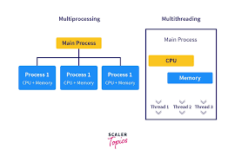
Multi-threading (The "Waiting" Room)
The Analogy: Imagine a waiter in a restaurant. The waiter takes an order, gives it to the kitchen, and then immediately moves to the next table while the food is cooking. They don't just stand there waiting.
The Use Case: Threading is perfect for I/O-bound tasks (Input/Output). This includes downloading files, querying a database, or waiting for an API response.
How it works: Python switches between "threads" so fast that it looks like they are running at once, even though they are technically sharing one CPU core.

Slide 3
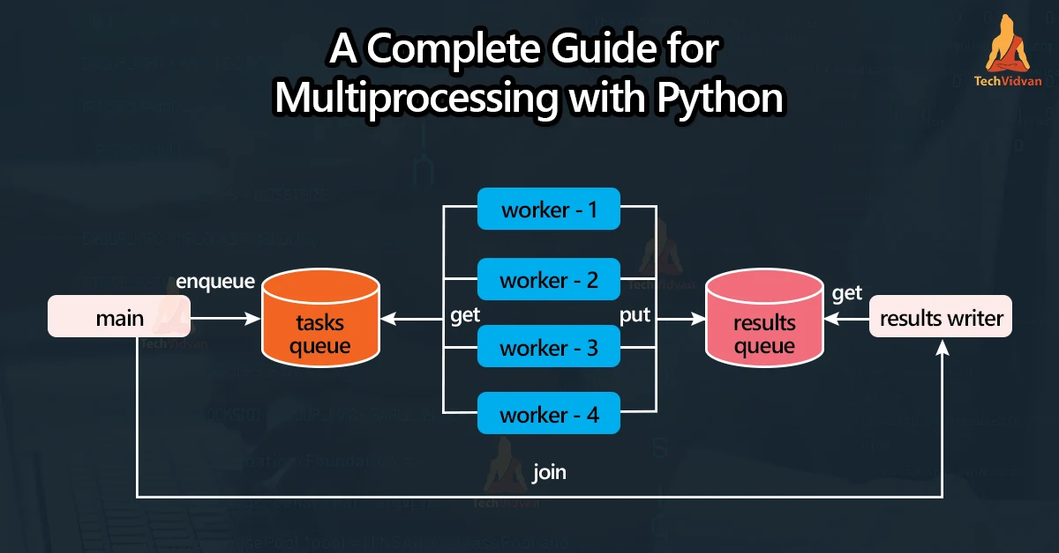
Multiprocessing (The "Factory" Floor)
The Analogy: Instead of one waiter, imagine you hire four separate chefs, each with their own stove and kitchen. They all cook different meals at the exact same time.
The Use Case: Multiprocessing is for CPU-bound tasks. This includes heavy mathematical calculations, image processing, or training AI model components.
How it works: It bypasses Python's limitations by launching entirely separate instances of Python on every core of your CPU (e.g., using all 8 cores of an i7 processor).

Slide 4
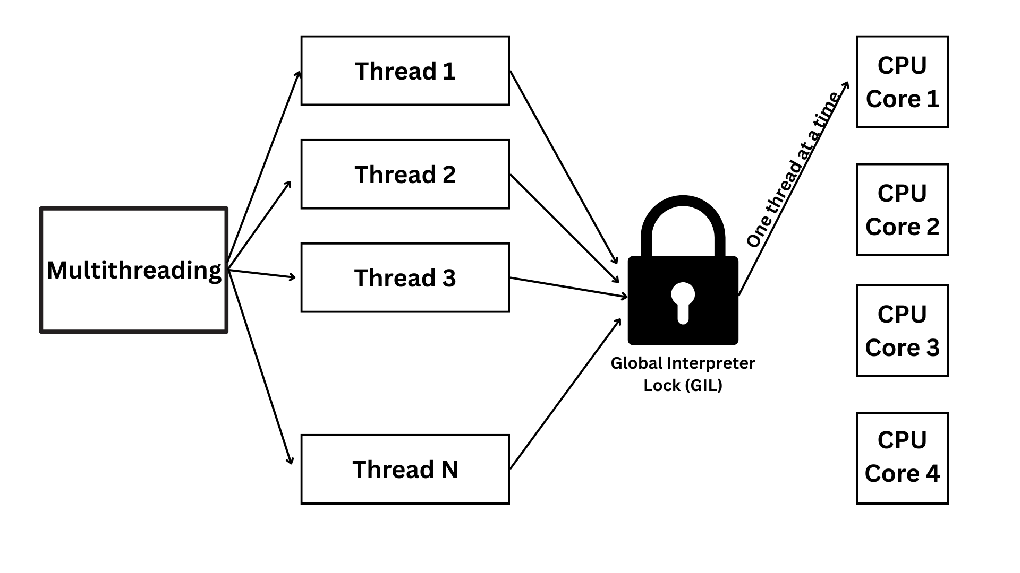
The GIL (The Traffic Cop)
What is it? The Global Interpreter Lock (GIL).
The Conflict: To prevent your computer's memory from getting corrupted, Python only allows one thread to hold control of the Python interpreter at a time.
The Impact: This is why Multi-threading doesn't make math faster in Python—the GIL acts like a "Traffic Cop" that only lets one car through the intersection at a time. To truly go fast with math, we must use Multiprocessing to create new "intersections."

Slide 5
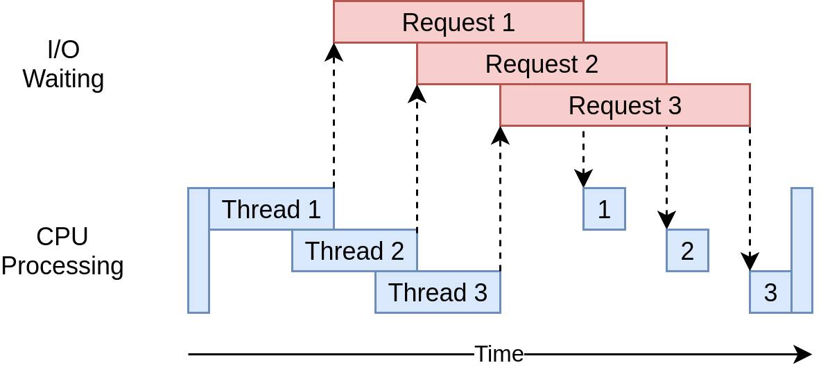
Advanced Concurrency Scenarios
Scenario A (I/O Bound): You are building a monitoring dashboard for 10 different AI microservices. You need to check the status of all of them every minute.
Without Threading: You wait for Service A, then Service B... the total time is the sum of all wait times.
With Threading: You fire all requests at once. The total time is only as long as the slowest single service.

Slide 6
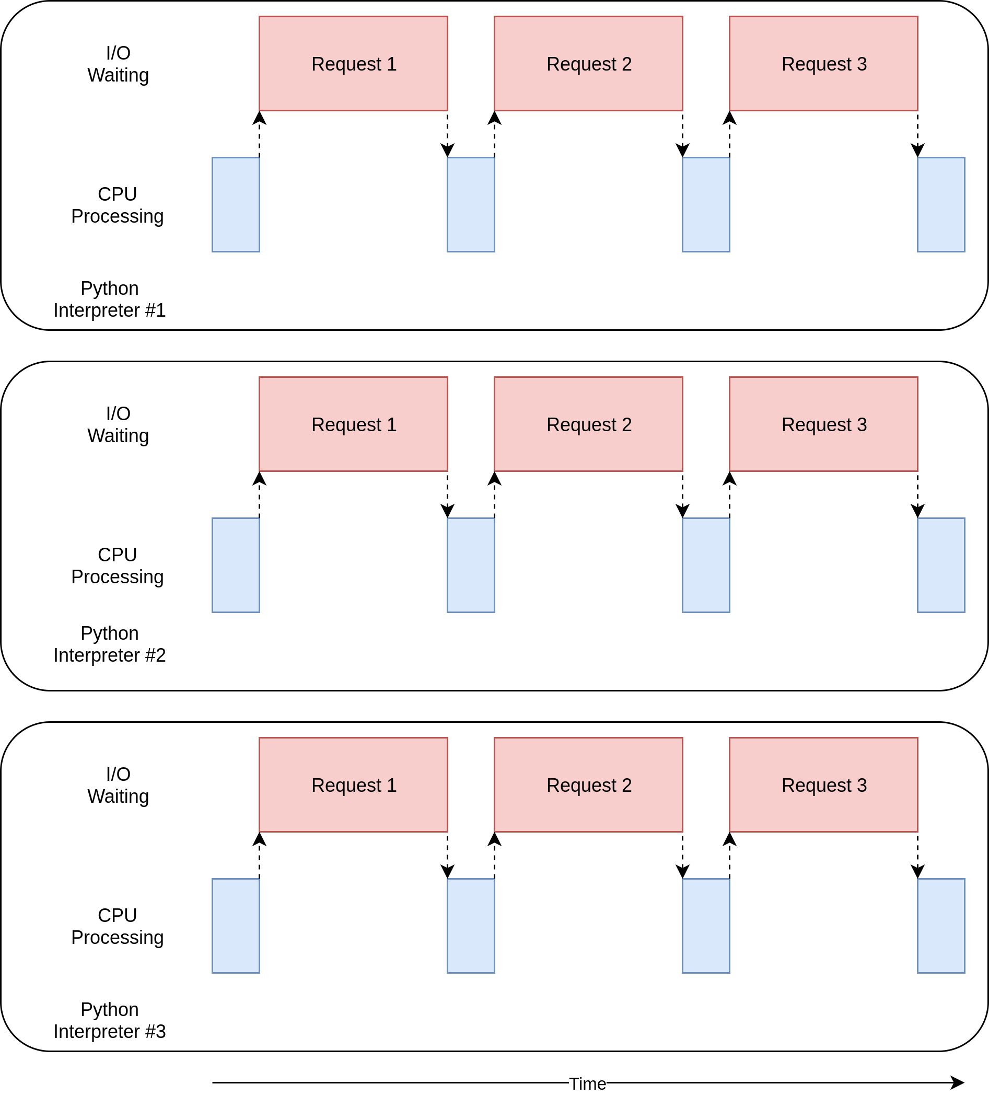
Advanced Concurrency Scenarios
Scenario B (CPU Bound): You have a dataset of 1,000 thermal images that need to be grayscaled and resized before entering a YOLO model.
Without Multiprocessing: One CPU core works on Image 1, then Image 2. It is a slow, sequential crawl.
With Multiprocessing: Your 8-core CPU handles 8 images at the exact same time. The processing speed increases by nearly 800%.

